Slide 1
Graduate Artificial Intelligence CS 640 Learning Hidden Markov Models
Jeffrey Considine
jconsidi@bu.edu

Slide 2

Plan for Today
Evaluation and recognition algorithms (continued)
Learning hidden Markov models
Expectation maximization
Baum-Welch algorithm

Slide 3
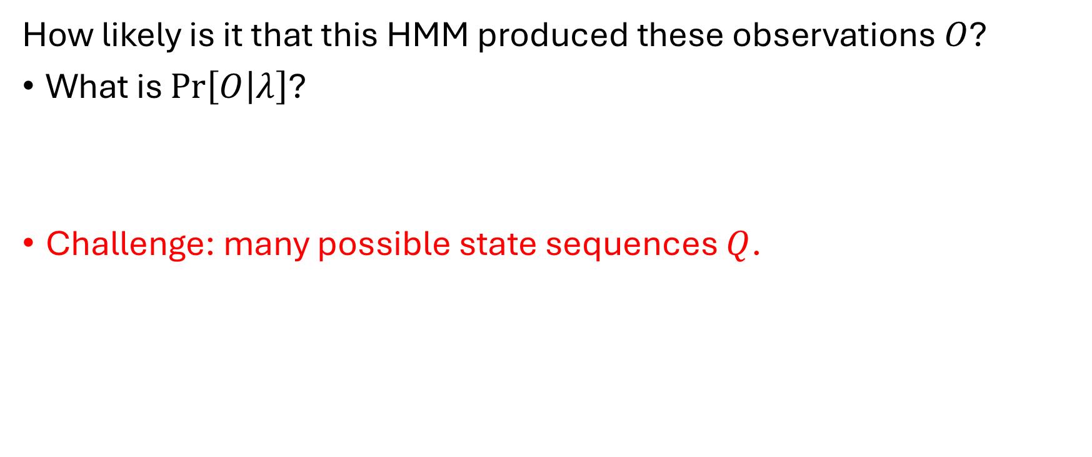
Evaluation Problem for HMMs
How likely is it that this HMM produced these observations $O$?
What is $\operatorname{Pr}\left[O | λ\right]$?
Challenge: many possible state sequences $Q$.

Slide 4
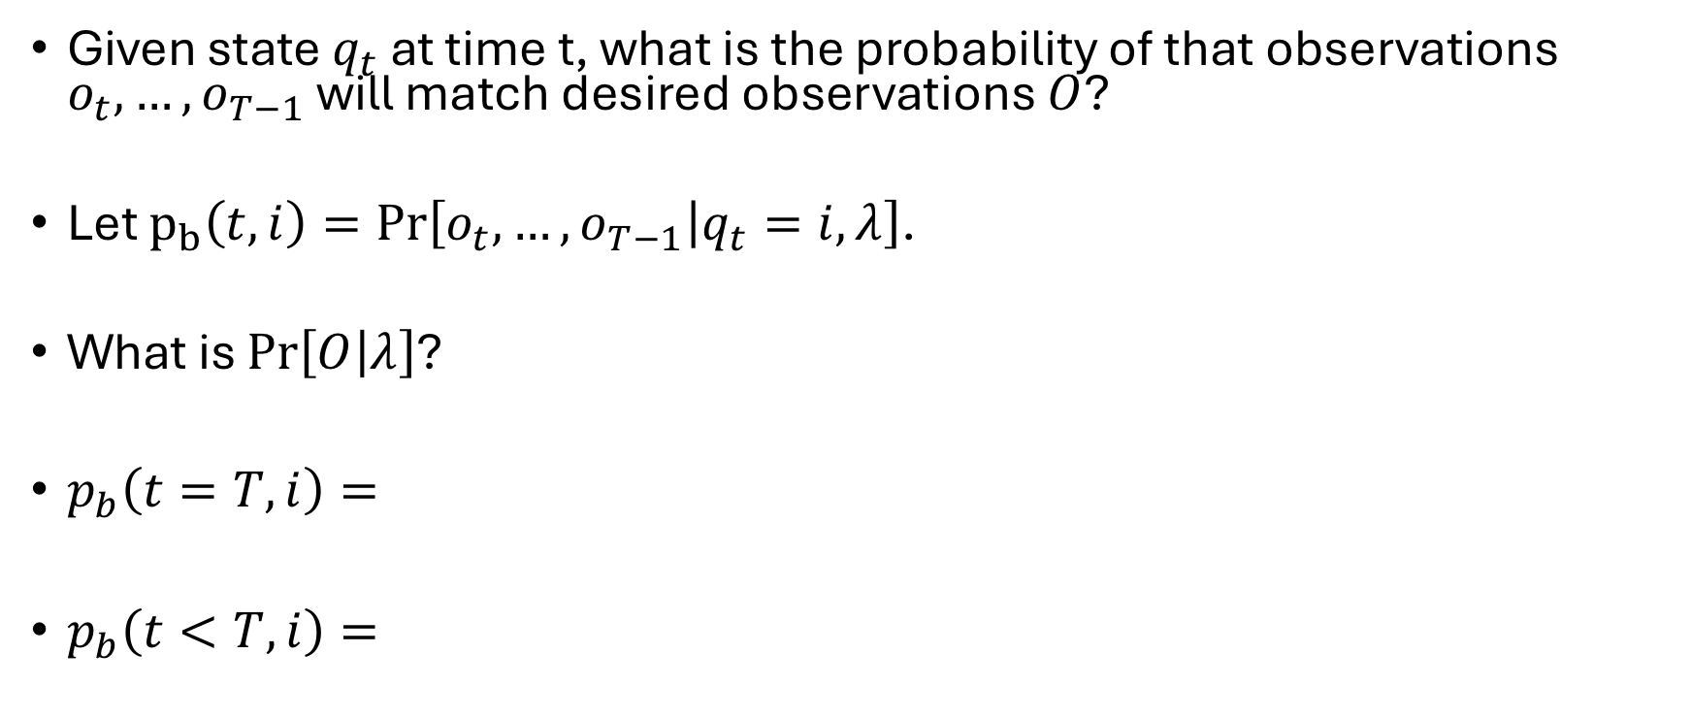
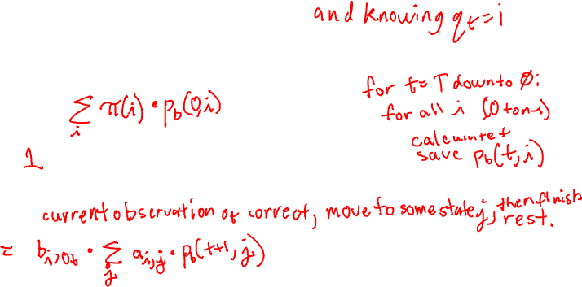
Backward Algorithm
Given state $q_{t}$ at time t, what is the probability of that observations $o_{t},…, o_{T−1}$ will match desired observations $O$?
Let $p_{b}\left(t, i\right)=\operatorname{Pr}\left[o_{t},…, o_{T−1} | q_{t}=i,λ\right]$.
What is $\operatorname{Pr}\left[O | λ\right]$?
$p_{b}\left(t=T,i\right)=$
$p_{b}\left(t<T, i\right)=$

Slide 5
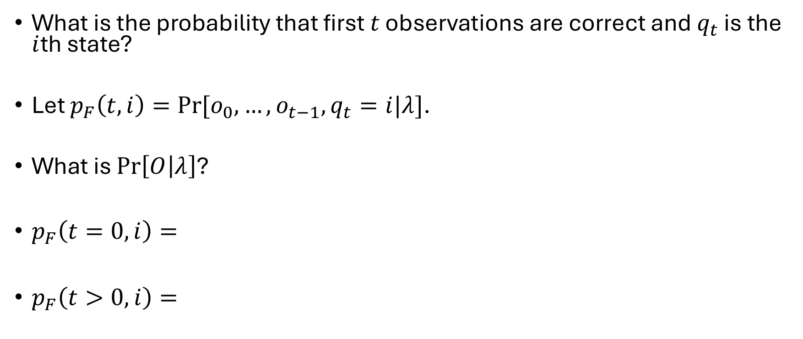
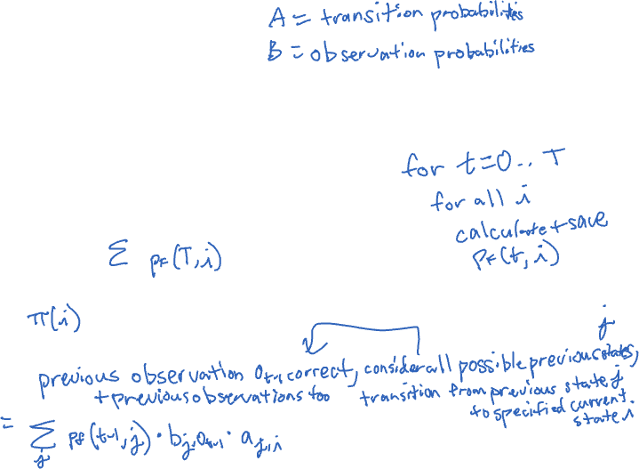
Forward Algorithm
What is the probability that first $t$ observations are correct and $q_{t}$ is the $i$th state?
Let $p_{F}\left(t, i\right)=Pr⁡[o_{0},…,o_{t−1},q_{t}=i|λ]$.
What is $\operatorname{Pr}\left[O | λ\right]$?
$p_{F}\left(t=0,i\right)=$
$p_{F}\left(t>0,i\right)=$

Slide 6
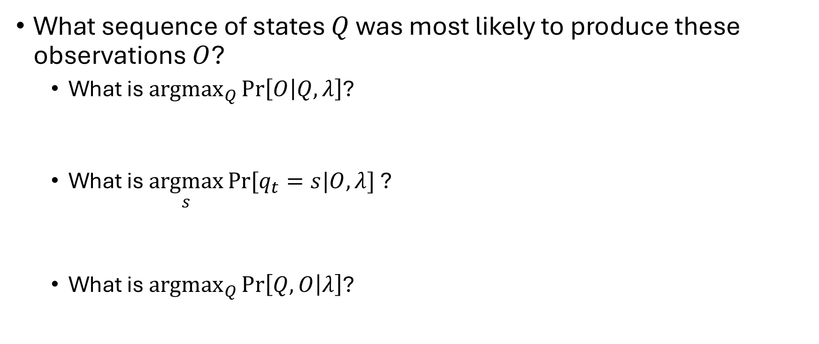
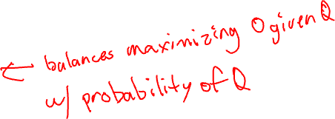
Recognition Problem
What sequence of states $Q$ was most likely to produce these observations $O$?
What is ${argmax}_{Q}{\operatorname{Pr}\left[O | Q,λ\right]}$?
What is $\underset{s}{argmax}{Pr⁡[q_{t}=s|O,λ] }$?
What is ${argmax}_{Q}{\operatorname{Pr}\left[Q,O | λ\right]}$?

Slide 7
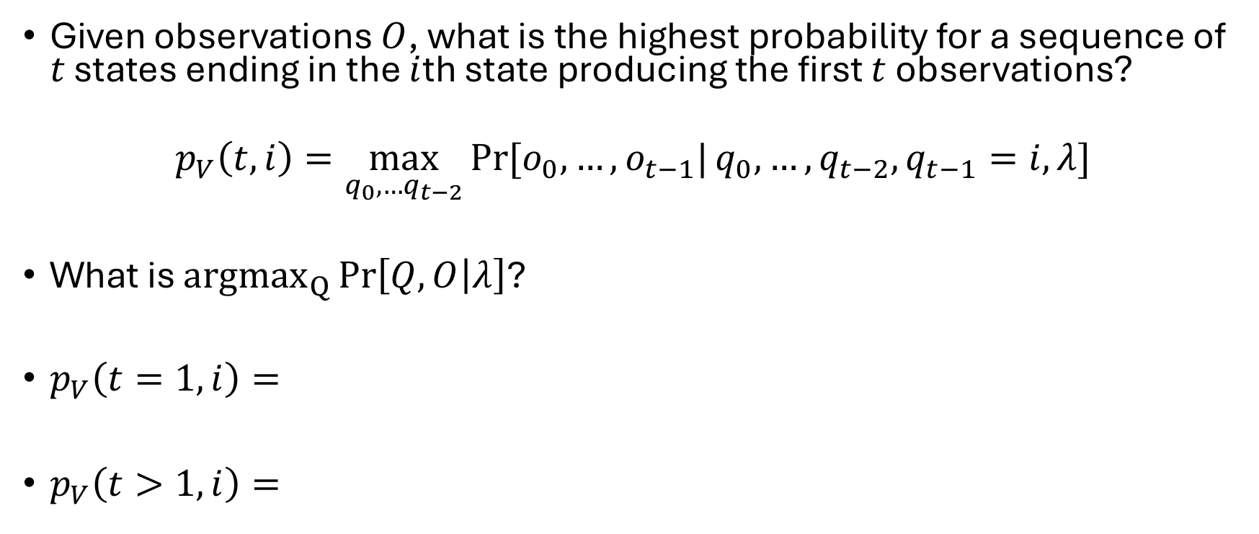
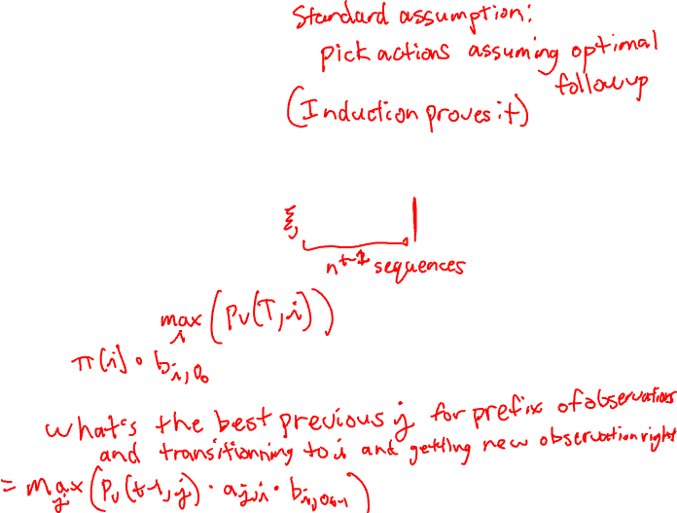
Viterbi Algorithm
Given observations $O$, what is the highest probability for a sequence of $t$ states ending in the $i$th state producing the first $t$ observations?
$$p_{V}\left(t,i\right)=\max_{q_{0},…q_{t−2}}{Pr⁡[o_{0},…,o_{t−1}|}q_{0},…,{q_{t−2},q}_{t−1}=i,λ]$$
What is ${argmax}_{Q}{\operatorname{Pr}\left[Q,O | λ\right]}$?
$p_{V}\left(t=1,i\right)=$
$p_{V}\left(t>1,i\right)=$

Slide 8
Any Questions?
Moving On
???
Evaluation and recognition algorithms
Learning hidden Markov models
Expectation maximization
Baum-Welch algorithm

Slide 9
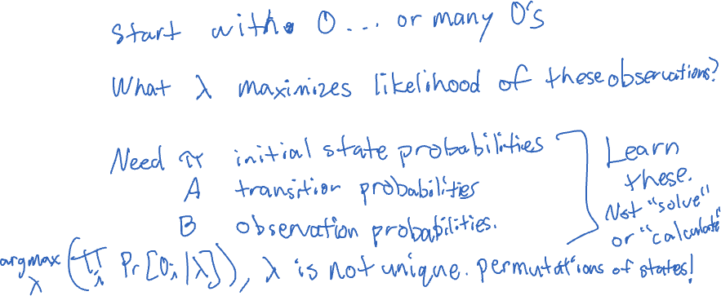
Learning Hidden Markov Models
What do we mean by this?

Slide 10
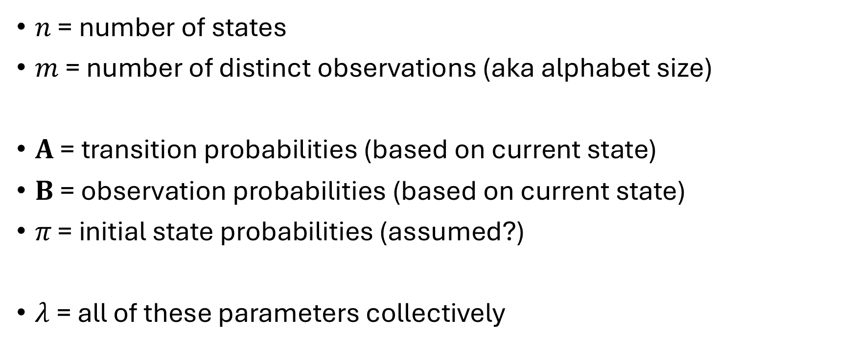
Formalizing Hidden Markov Models
$n$ = number of states
$m$ = number of distinct observations (aka alphabet size)
$A$ = transition probabilities (based on current state)
$B$ = observation probabilities (based on current state)
$π\text{ = }\text{initial} \text{state} \text{probabilities}$ (assumed?)
$λ$= all of these parameters collectively

Slide 11

Formalizing Hidden Markov Models (cont)
$O=[o_{0},o_{1},…,o_{T−1}]$ observations (known)
$Q=[q_{0},q_{1},…, q_{T−1}]$ true states (unknown)

Slide 12
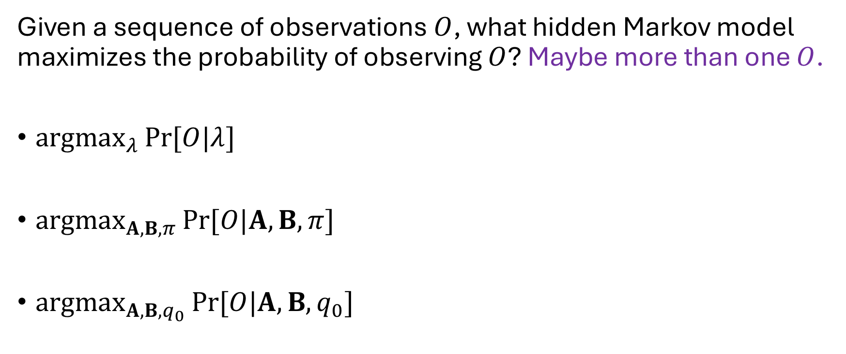

Learning Hidden Markov Models (take 2)
Given a sequence of observations $O$, what hidden Markov model maximizes the probability of observing $O$? Maybe more than one $O$.
${argmax}_{λ}{Pr⁡[O|λ]}$
${argmax}_{A,B,π}{Pr⁡[O|A,B,π]}$
${argmax}_{A,B,q_{0}}{Pr⁡[O|A,B,q_{0}]}$

Slide 13
Learning Constrained HMMs
Similar but separate problem to learn HMMs with a particular graph of transitions.
Today’s algorithm can be adapted but will skip that today.

Slide 14
Disclaimers about Learning HMMs
Permutations
Unlikely to get exact match

Slide 15
Any Questions?
Moving On
???
Evaluation and recognition algorithms
Learning hidden Markov models
Expectation maximization
Baum-Welch algorithm

Slide 16
Expectation Maximization
An approach to maximizing likelihood of events (observations).
Assumes hidden latent variables (states) drive behavior.
Alternates between two phases.
Expectation: Analyze distribution of latent variables conditioned on success using current model parameters.
Maximization: Tweak the model parameters to maximize the likelihood of at expectation.

Slide 17
Why Rounds of Expectation Maximization?
Maximization goal is to increase probability of success cases.
Maximization steps do not increase all success cases uniformly.
So, the conditional latent distribution changes.
So, maximization has more areas for improvement.

Slide 18
EM and Old Faithful Geyser Eruptions
Animation source: https://en.wikipedia.org/wiki/Expectation%E2%80%93maximization_algorithm

Slide 19

What if Just Observations were Optimized?
So, just optimize $B$. Keep $A$ and $π$ fixed.
What is $Pr⁡[q_{t}=i|A,π,t]$?
How do we maximize $Pr⁡[o_{t}|A,π,t]$? Just maximizing step $t$.

Slide 20

How do We Optimize All Time Steps at Once?
So, just optimize $B$. Keep $A$ and $π$ fixed.
What is $Pr⁡[q_{t}=i|A,π,t]$?
What is $\operatorname{Pr}{[o_{t}=j|}A, π,q_{t}=i]$? Note not conditioned on $t$.

Slide 21
Why Match the Conditional Probability?
???

Slide 22
Any Questions?
Moving On
???
Evaluation and recognition algorithms
Learning hidden Markov models
Expectation maximization
Baum-Welch algorithm

Slide 23
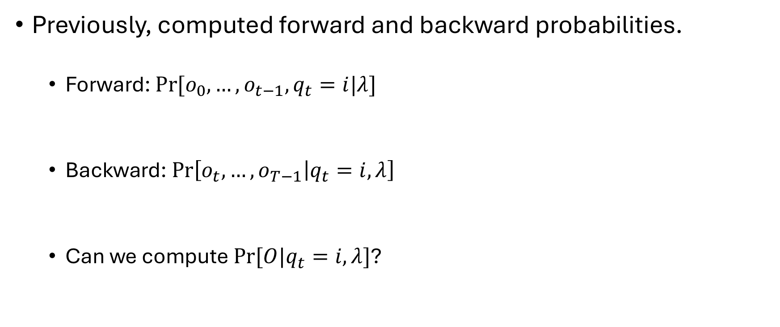
How do we characterize the distributions of states conditioned on the observations?
Previously, computed forward and backward probabilities.
Forward: $Pr⁡[o_{0},…,o_{t−1},q_{t}=i|λ]$
Backward: $\operatorname{Pr}\left[o_{t},…, o_{T−1} | q_{t}=i,λ\right]$
Can we compute $Pr⁡[O|q_{t}=i,λ]$?

Slide 24

What else can we compute?
$Pr⁡[O]$?
$\operatorname{Pr}\left[q_{t}=i | O\right]$?
$Pr⁡[q_{t}=i,q_{t+1}=j|O]$?

Slide 25
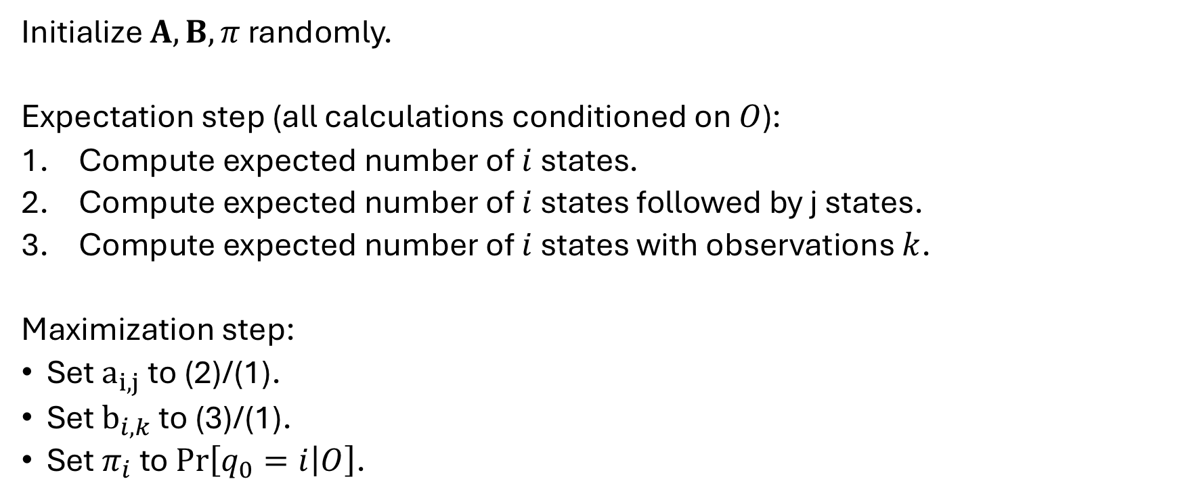
Baum-Welch Algorithm
Initialize $A, B, π$ randomly.
Expectation step (all calculations conditioned on $O$):
Compute expected number of $i$ states.
Compute expected number of $i$ states followed by j states.
Compute expected number of $i$ states with observations $k$.
Maximization step:
Set $a_{i,j}$ to (2)/(1).
Set $b_{i,k}$ to (3)/(1).
Set $π_{i}$ to $\operatorname{Pr}\left[q_{0}=i | O\right]$.

Slide 26
Does Baum-Welch Return an Optimal HMM?
???

Slide 27
Repeating Baum-Welch
Randomized algorithm:
Run Baum-Welch many times with different initial models.
Keep the model with the best conditional likelihood of the observations.

Slide 28
Any Questions?
Next Time
???
Midterm (Thursday 10/16)

